Slide 1

Real-Time Multi-Object Tracking with YOLOv8 & DeepSort
Group ID : 20
Devvrat Deval (M25MER008)
Satyam Sharma (b22CS047)
Sanjeet Athawale (B22EE014)

Slide 2
01
Introduction & Problem

Slide 3
Problem Statement
The primary challenge is to track multiple objects across video frames with consistent IDs, despite occlusions, similar appearances, sudden motions, and the requirement for real-time processing
.

Slide 4
Why Joint Tracking Matters
Multi-object tracking and segmentation are vital for surveillance, autonomous vehicles, and human-computer interaction. The core challenge is associating detected objects across frames, managing occlusions, and adapting to appearance changes while maintaining real-time performance. Our work addresses these needs with modern tracking techniques.
Surveillance Systems
Autonomous Vehicles
Human-Computer Interaction

Slide 5
02
Prior Work

Slide 6
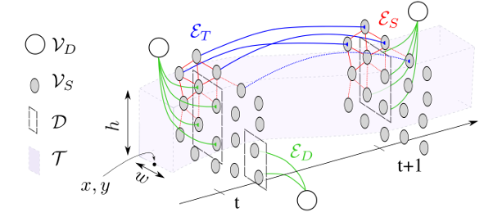
Milan et al.: A CRF-Based Approach
This method jointly formulates tracking and segmentation as a multi-label CRF problem. It models pixels and detections in a graph, combining unary and pairwise potentials to ensure label smoothness.
Strengths: Handles occlusion, provides pixel-level segmentation.
Weaknesses:Not real-time (≈12s/frame), high complexity, sensitive to parameters.

Slide 7
03
Our Solution

Slide 8
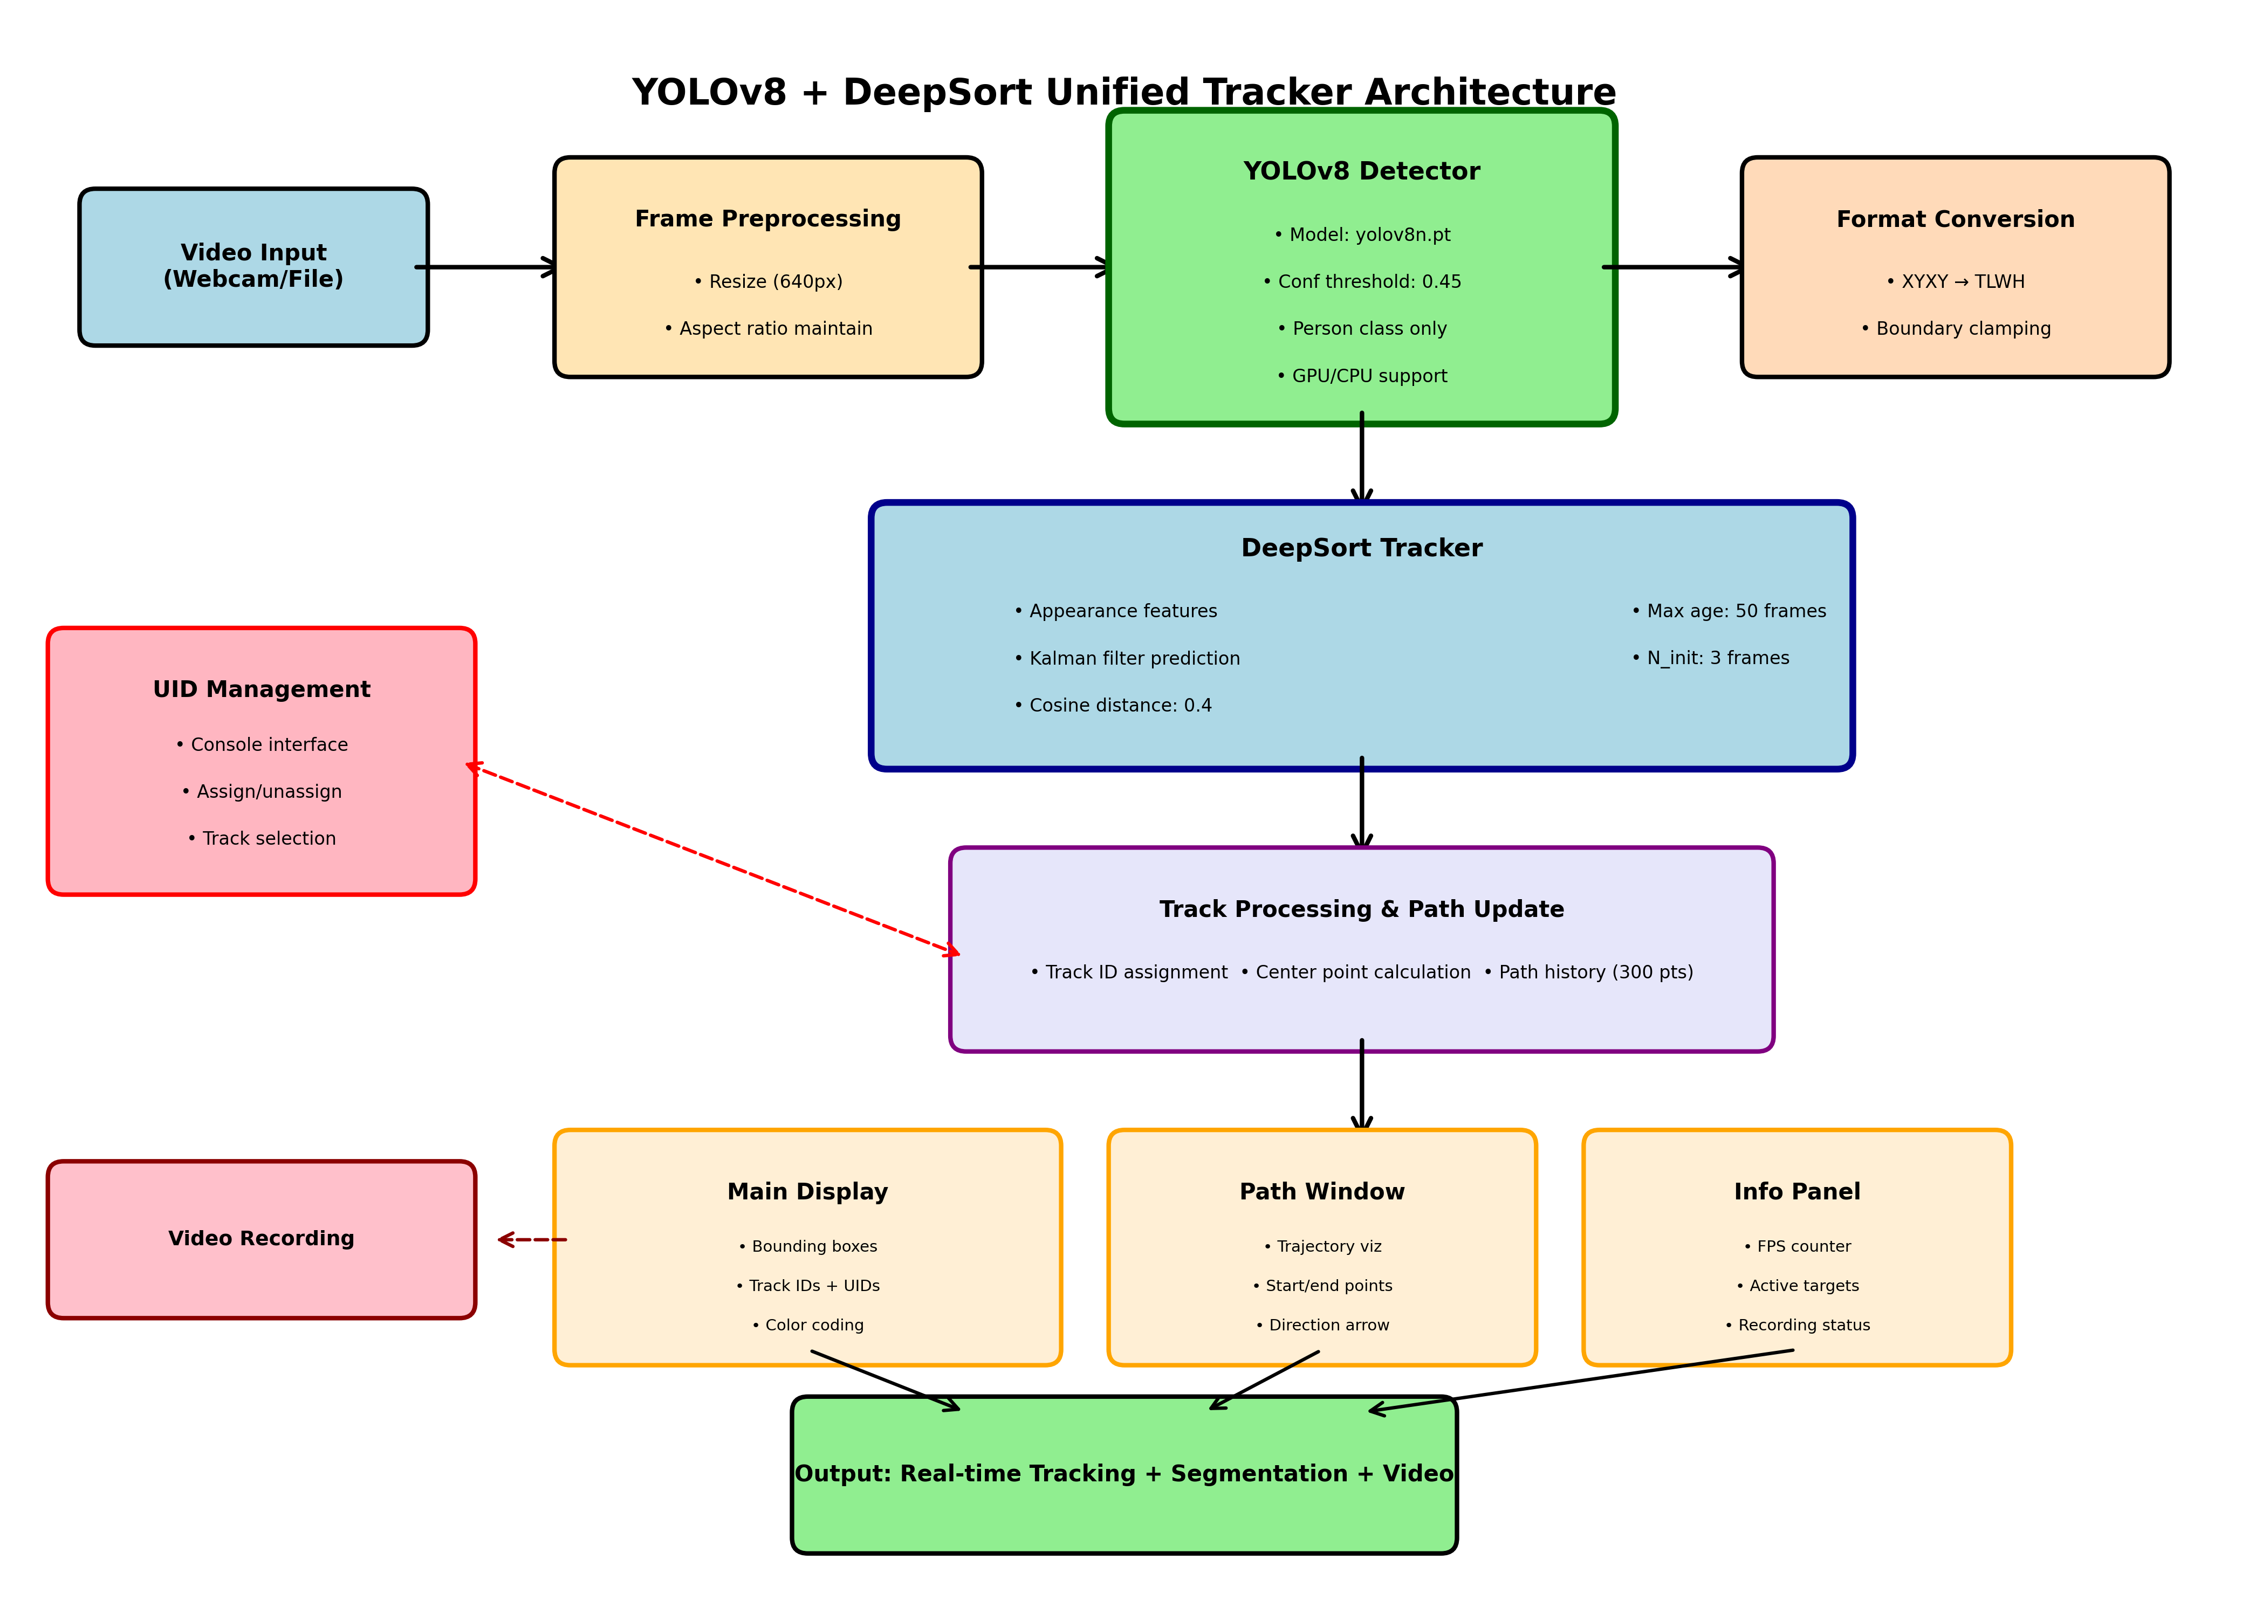
Architecture

Slide 9
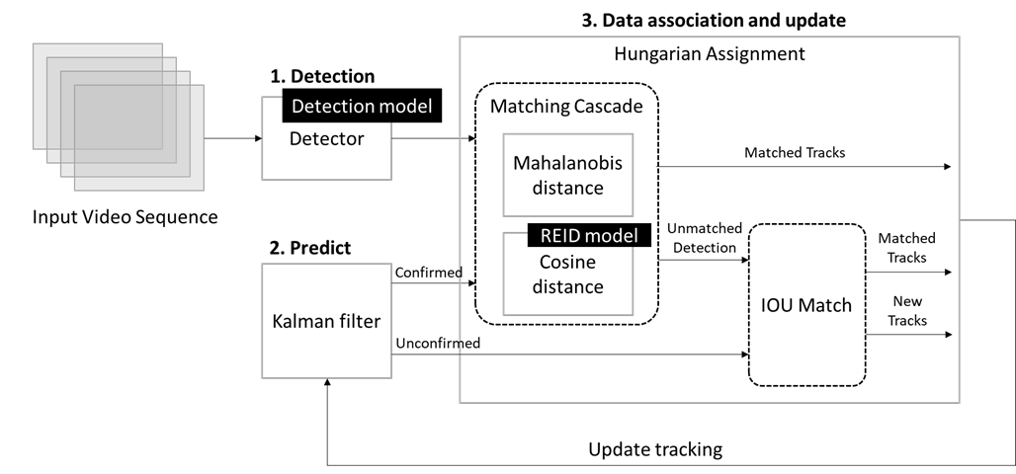
Detection using YOLO
YOLOv8n provides fast, accurate detections, which DeepSort uses for robust tracking. DeepSort's core integrates appearance features with Kalman filtering for state estimation and data association.

Slide 10
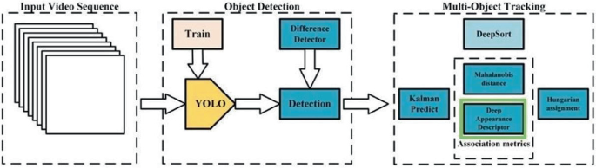
Using DeepSORT Object Tracker

Slide 11
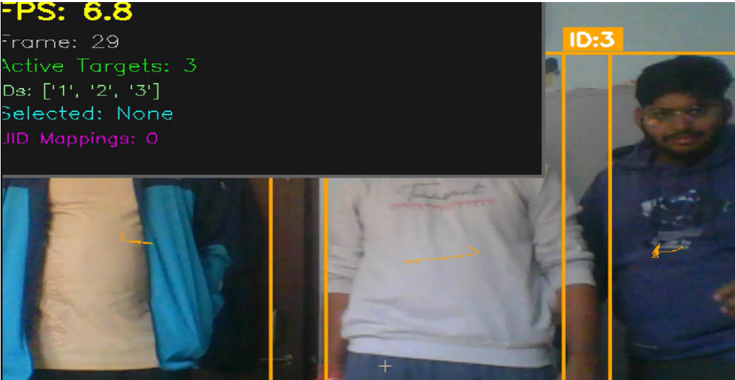
https://drive.google.com/file/d/13iqj1frtzsUp-CxQR26FMOe_2Iw7raUa/view
Result:

Slide 12
04
Comparing with CVPR Paper

Slide 13
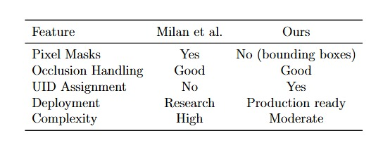
Comparison

Slide 14
05
Merits

Slide 15
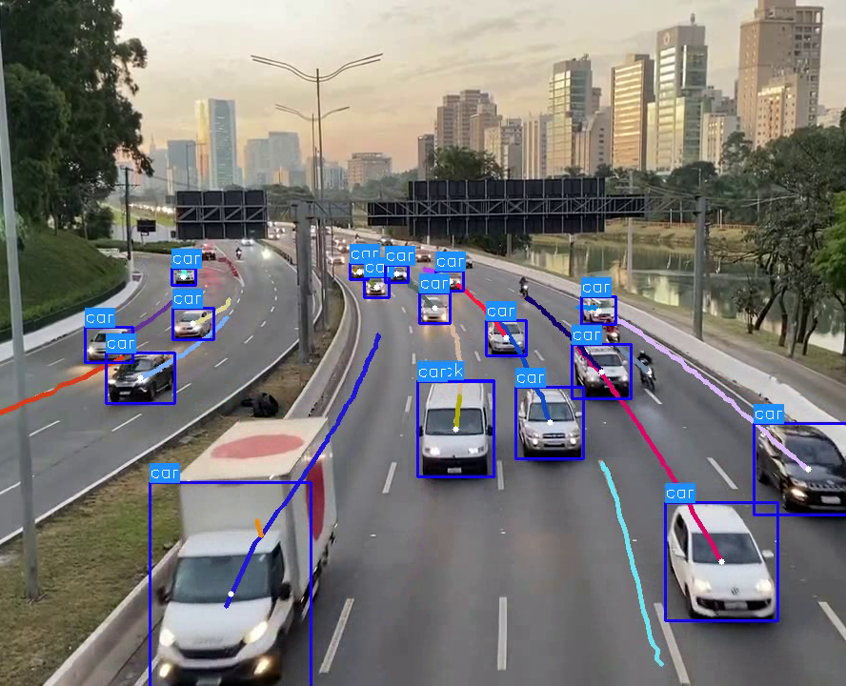
UID Assignment & Visualization
Users can interactively assign persistent IDs to tracked objects, enhancing usability for real-world applications. The system maintains a rich history for comprehensive analysis.
Features color-coded boxes and trajectory trails for intuitive monitoring.

Slide 16

Tracking Accuracy & Robustness
Qualitative results demonstrate accurate detection and tracking of multiple objects with minimal ID switches. The system effectively handles occlusion and re-identification.
Multiple objects tracked accurately across sequences.
Effective occlusion handling with DeepSort max age: 50.
Real-time video recording enabled for practical applications.

Slide 17
THANK YOU

